Slide 1
Cross Selling Credit Union
LISUM12: Data Glacier Final Project Presentation

Slide 2
Team Details
Group Name: Team Coltenback
Name: Richard Coltenback
Email: rdcoltenback@gmail.com
Country: United States of America
College: Drew University
Specialization: Data Analyst
GitHub Repository Link: https://github.com/RColtenback/Cross-Selling-Data-Analysis.git

Slide 3
Problem Description
XYZ credit union in Latin America is performing very well in selling banking products (e.g.: credit card, deposit account, retirement account, safe deposit box etc.). However, their existing customers are not buying more than one product which means the bank is not performing well in cross-selling (the bank is not able to sell their other offerings to existing customer). XYZ Credit Union decided to approach Team Coltenback to solve their problem.

Slide 4
Business Understanding
We’re trying to understand the advantages and disadvantages of cross-selling banking products as opposed to up-selling. In particular, we want to know the financial benefits of cross-selling products to understand which products do well together and which should be sold alone. We also have personal information about each customer for the bank, thus we can analyze their backgrounds and see if there is any correlation with certain personal traits (e.g.: race, age, sex, etc.).

Slide 5
Project Lifecycle and Deadline
1. Business understanding
2. Data Understanding
3. Data Cleansing and Transformation
4. Exploratory data analysis
5. EDA Recommendation (PowerPoint)
6. Dashboard which should capture type of customer their count, segment wise (VIP, student, etc.) customer average age, and other KPIs which gives better business insight in taking decision.
7. Prepare a final presentation
The final deadline is scheduled for October 30th, 2022.

Slide 6
Data Understanding
The dataset we will be using will be information given to us from the XYZ Credit Union. It has many different variables and lots of data that can help us solve our problem. The data has to deal with banking and different products that go along with it. Some examples of the variables are loans, pensions, mortgages, etc. Fortunately, due to the data collected being based on each customer, we also have access to personal information like their ages, sex, country of residence, etc. This dataset has a mix of different types of variables. Some variables like fecha_dato and fecha_alta are dates. Some variables like indext and indfall are Boolean or dichotomous as they are true/false or yes/no. Some variables like ind_empleado are string or nominal as they have letters for each customer. Finally, some variables like ncodpers and age are integer or scale as they have numbers for each customer.

Slide 7
Data Understanding
More about the dataset:
Train.csv
Total number of observations (rows) | 13647309
Total number of files | 1
Total number of features (columns) | 48
Base format of the file | .csv
Size of the data | 2.29 GB

Slide 8
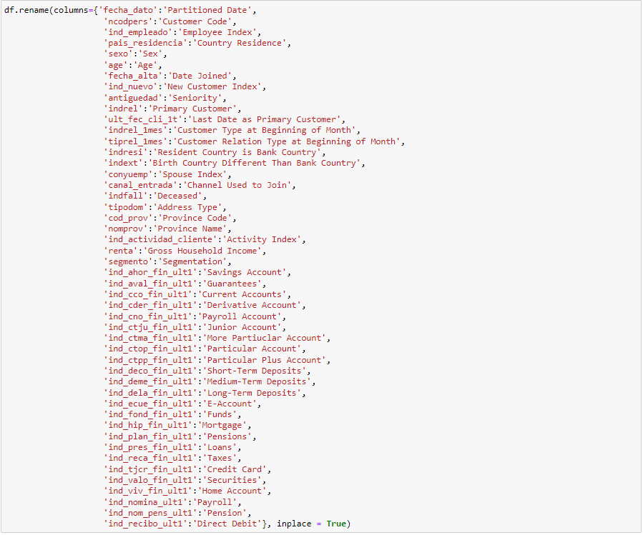
Data Cleansing and Transformation
My first goal for cleaning up this data was changing the names of the column variables. The original names were in Spanish and didn’t make sense to me. Using the column description, I changed the names of each variable to make them more understandable for an English speaking audience (I could change them back to Spanish after since this is a Latin American credit union). Next, I checked the types of variables and how many NA values there are in the dataset to help show me which variables need a work around.

Slide 9
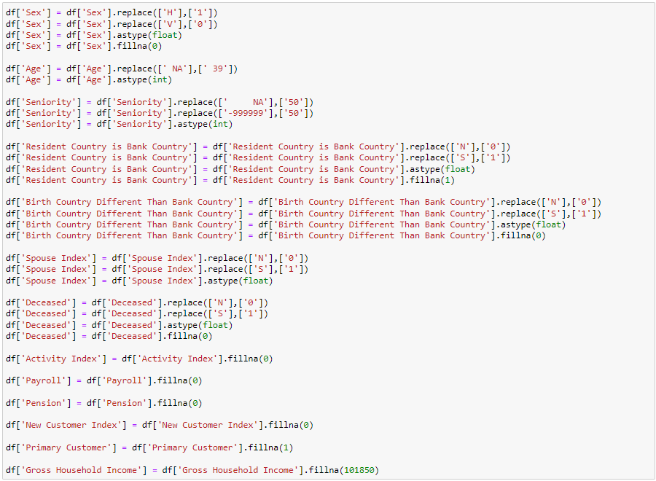
Data Cleansing and Transformation
Then, I found the mean, median, mode, and other attributes of a couple variables to have experience with them. Using the median, I was able to fill the NA values for each variable, not changing anything about the data and the trends. Also, the amount of NA values for each variable I changed wouldn’t have enough weight to statistically significantly impact the data. Finally, I changed some of the numeric variables from objects to integers or float to make exploring the data easier.

Slide 10
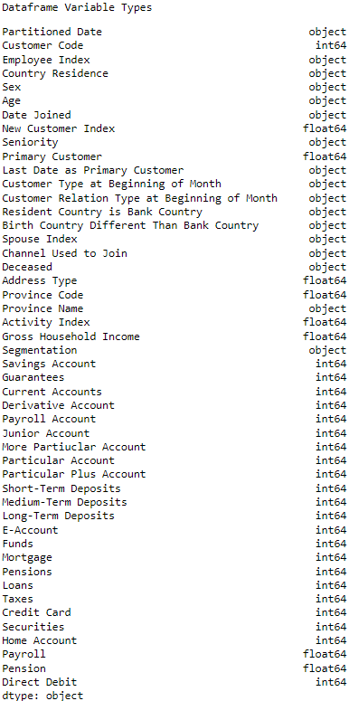
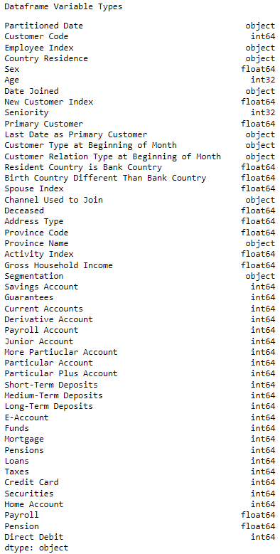
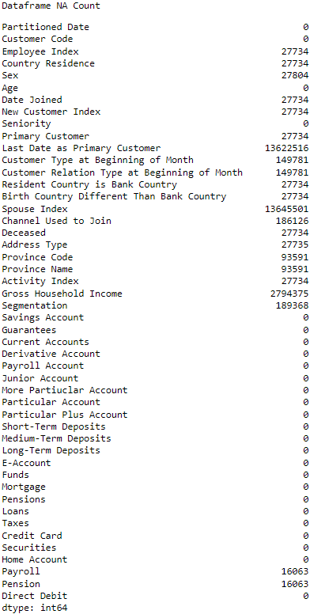
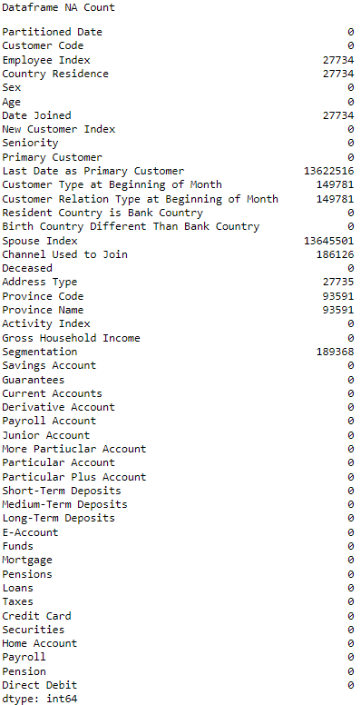
Data Cleansing and Transformation

Slide 11
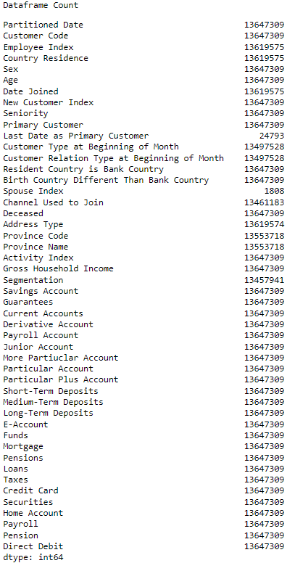
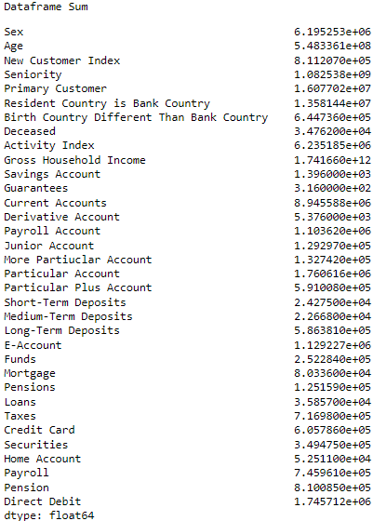
Exploratory Data Analysis
I began the exploratory data analysis (EDA) by taking the little experience I gained from cleaning and transforming the data and applying it by finding all the count values of each variable and the sum of each variable to get a vague sense of how many accounts there were in all the options that the bank offered.

Slide 12
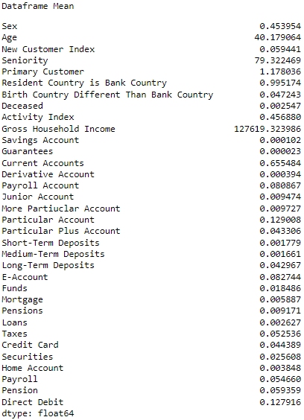
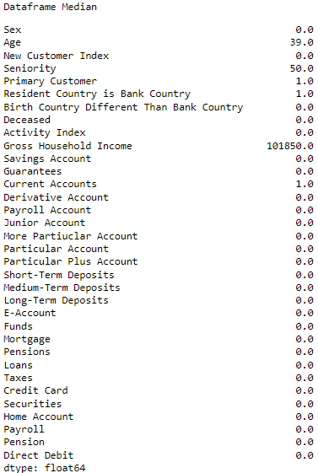
Exploratory Data Analysis
I then found the means and medians of each variable to see which accounts of the bank were doing better than the others.

Slide 13
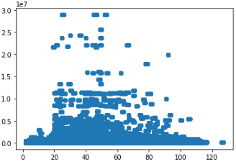
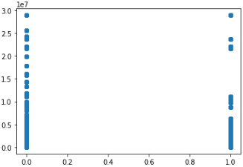
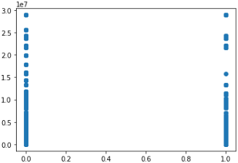
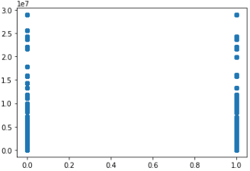
Exploratory Data Analysis
Gross Household Income by Age
Gross Household Income by E-Account
Then, I created some visualizations with the variables and compared them to gross household income. I did this assuming the greater the wealth of a family, the greater the possible amount of money that could be trusted with the bank. Though the visualizations helped a little, they couldn’t paint a full picture.
Gross Household Income by Direct Debit
Gross Household Income by Activity Index

Slide 14
Exploratory Data Analysis
I decided to find the correlation (Pearson’s r) values between each of the variables, with special interest in gross household income, to see if I could find any correlations between them. Although it wasn’t giving me all the information I wanted, specifically for the variables of Sex and Age, I changed a couple of the variables to make them able to be correlated. I then analyzed all the statistically significant correlations and they helped me come to a final conclusion. Therefore, with the information I received before from the means and medians, and the recent information with the correlation coefficients, I was able to come to a final recommendation.

Slide 15
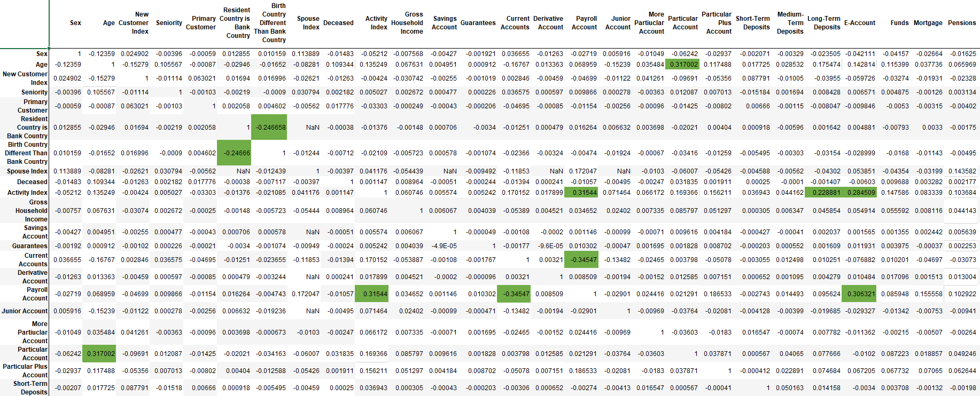
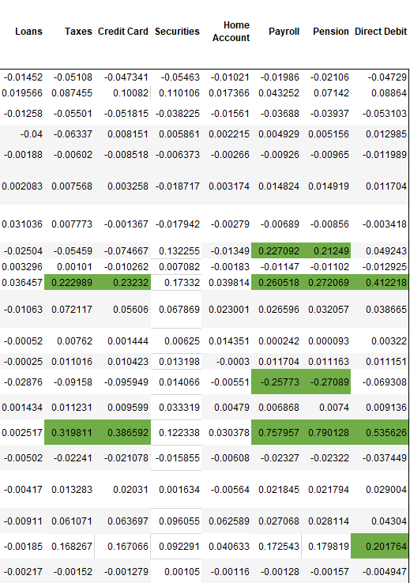
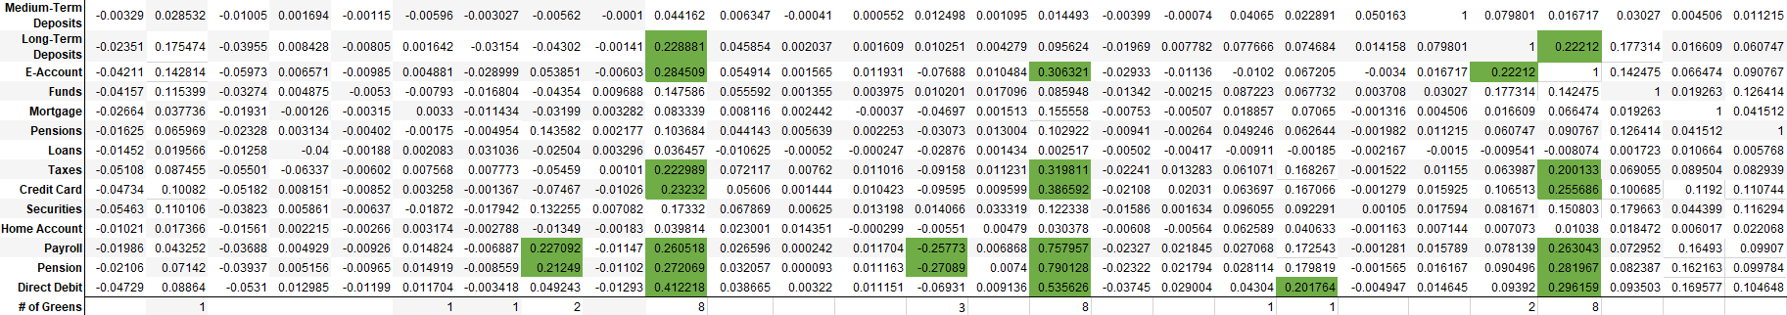
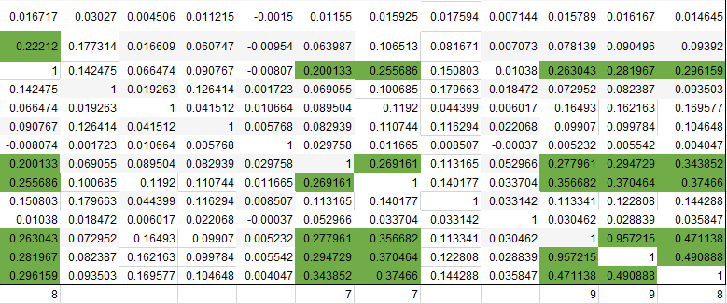
Full Correlation Table

Slide 16
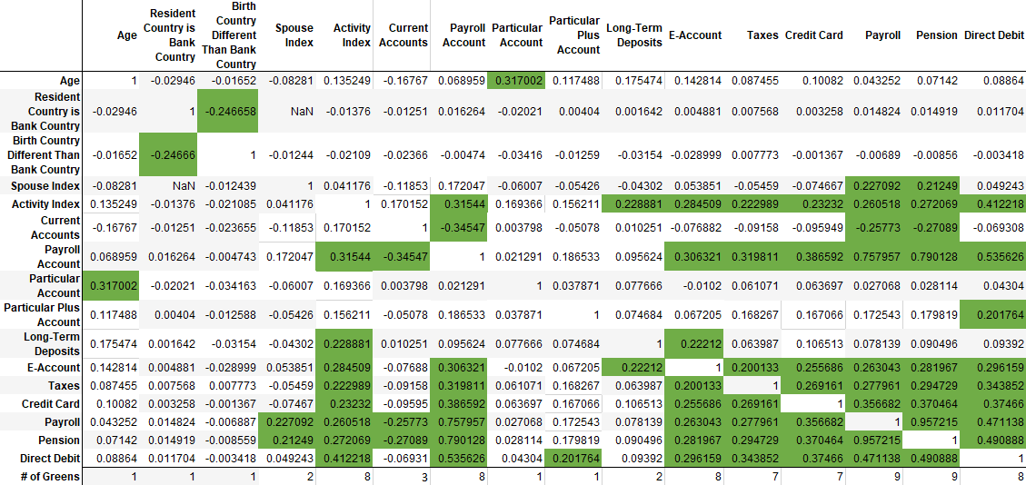
Statistically Significant Findings

Slide 17
Final Recommendation
I would like to begin this final recommendation with the saying that, “Correlation does not imply causation”. Although, trends say one thing, you are not always guaranteed the outcome you seek. With that being said, my final recommendation is this. In the prompt, we are told the XYZ Credit Union is performing very well in the selling of their banking products. Although they aren’t where they’d like to be with cross selling to their existing customers, they are still doing well selling individual products. They might not be maximizing their revenue, but their business model is drawing in new customers and keeping them long term. Pushing new accounts on your existing customers could turn them away. I would say you could try cross selling to new customers that enter your credit union, but not the ones who have been loyal for many years. Despite this, there are ways of making more profit by cross selling certain accounts together. So, if you did want to try making more revenue through cross selling, this is how you could do it.

Slide 18
Final Recommendation
Shockingly, from the correlation coefficient findings, gross household income is not a good variable which should be tested with bank success. It wasn’t statistically significant with any other of the variables we used. The variables best correlated with other banking variables were activity index, payroll account, e-account, taxes, credit card, payroll, pensions, and direct debit. Looking deeper into a few of those variables, starting with activity index, we can see that it’s statistically significantly positively correlated with payroll accounts, long-term deposits, e-accounts, taxes, credit card, payroll, pensions, and direct debit. In short, this means that customers who are active with their account tend to also have multiple types of banking accounts, specifically the accounts listed above. This means that if you were trying to cross sell, do it with active customers. Try getting them signed up for one of these account types, with a priority in direct debit, e-accounts, payroll accounts, pensions, payroll, taxes, and credit card, as these are the most used accounts out of all their customers. Moreover, these accounts are all statistically significantly positively correlated with each other.

Slide 19
Final Recommendation
If you have an older customer, the statistics show that they are more likely to have a particular account with the credit union. Also, particular accounts are one of the most popular accounts to have in this credit union. Thus, I would try pushing those types of accounts to older customers who don’t already have one.
Customers that already have an account at the credit union tend to not have a payroll account or pension. This probably means that they use other banking competitors to handle those accounts. Maybe with some more open minded customers, you could be able to convince them to switch over to your credit union. This would make those variables more highly correlated, especially if they are an active customer, and could create more usage for your credit union.

Slide 20
Final Recommendation
Particular plus accounts have a statistically significantly positive relationship with direct debit. This makes sense as particular plus accounts deal with checking accounts and so do debit cards. Therefore, if someone is trying to sign up for a checking (particular plus) account, try offering direct debit, as it would line up with the wants of the customer.
To keep up with an increasing technologically driven world, the statistics and I highly recommend pushing e-accounts. It is positively correlated with many of the highest used banking accounts, and it provides simplicity and convenience for many, if not all, of your customers.

Slide 21
Final Recommendation
There are no statistically significant differences between gender and banking. Although 55% of the customers are male, there is no difference in the amount of accounts that both males and females use. Thus, you shouldn’t treat them differently, and you shouldn’t offer different accounts based on sex.
Finally, using the means of each of the different banking account types, I have found that the top five most used accounts are: particular account, direct debit, e-account, payroll account, and pension; and the five least used accounts are: guarantees, savings account, derivative account, medium-term deposits, and short-term deposits. With this information, you can promote what is working best for the XYZ Credit Union, or try promoting the lesser used accounts in hopes of attracting different types of customers. However, I wouldn’t try and deviate too far from what is already being done, since the XYZ Credit Union is doing well already.

Slide 22
Modeling Technique
The best models for this problem/dataset should be predictive models. Specifically, models that use linear and multiple regression. Using the statistically significant values from the correlation coefficient table, along with means, medians, counts, sums, and regression equations, we can attempt to predict the best combination of cross selling techniques for the XYZ Credit Union.

Slide 23
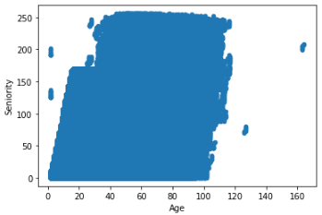
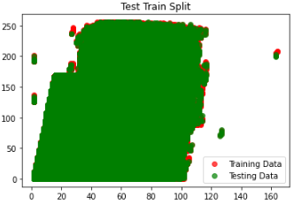
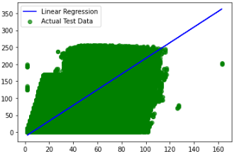

Linear Regression Model
The first predictive model I used to attempt to predict the best combination of cross selling techniques was linear regression. I started with a regular scatterplot to get an overall understanding of each of the variables being used.
I then used the train, test, split as my method of prediction, and made a graph.
Next, I plotted the actual test data with a linear regression line to make an accurate graph.
Finally, I created a regression equation, with a linear regression score, and was able to make a prediction based on inputting a number for x.

Slide 24

Multiple Regression Model
The second predictive model I used was multiple regression. I focused less on visualizations for multiple regression as it is similar to linear regression, except it has more regression lines. I took the variables with two or more other variables that were statistically significantly correlated to it and tested the multiple regression. I was able to make a prediction for each dependent variable, along with finding the regression equation with the slope values and an intercept. Here is an example of what the output looks like:

Slide 25
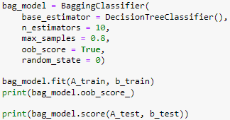
Ensemble Model
I noticed while using linear regression that the prediction score was very low for most of the variables. Multiple regression would make that number a little better but not enough to feel confident in an accurate prediction. Thus, I decided to use an ensemble model to see if I could increase prediction accuracy. Similar to linear regression, I used a test, train, split model to find a baseline prediction. Then, using a bagging classifier and increasing the number, and therefore accuracy, of parameters like n estimators, I was able to output a better score of prediction. The top number is the model using the train values of the variables, and the bottom number is the model using the test values of the variables. We can see that the outcomes are very good, all producing an accuracy score of 95% or better.

Slide 26
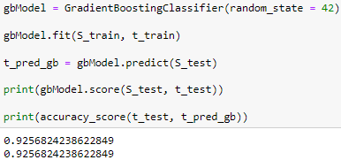
Boosted Model (Gradient Boosting Model)
Although the numbers of the ensemble model were great, I think it’s important to have multiple accurate models to use in case one isn’t available to us, or to see if we can make the accuracy score better still. For this model, I used a boosted model (gradient boosting model) to test the accuracy of the model. This one too used a train, test, split approach, then, using a gradient boosting classifier, I was able to make two predictions. The top prediction based on the variables’ tested accuracy score, and the bottom prediction testing it against the gradient boosting model’s predicted variables. The model generated very accurate scores, much more accurate than the linear regression scores. However, not as accurate as the scores from the ensemble model. I would still have confidence using the boosted model.

Slide 27
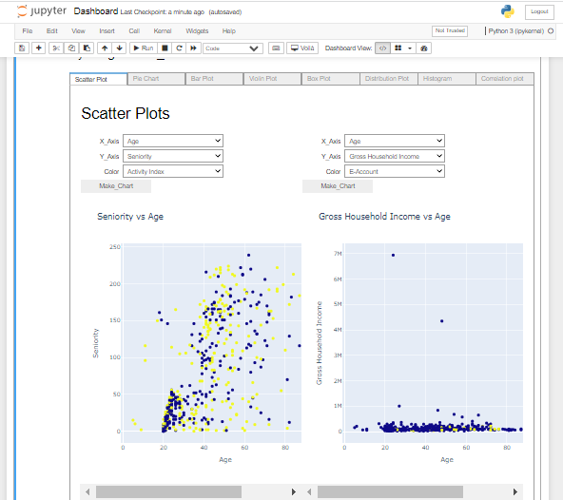
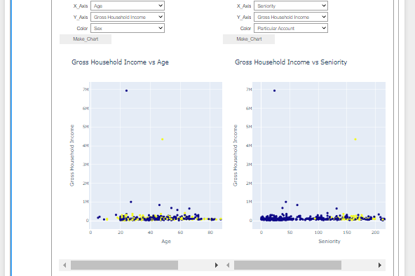
Dashboard Visualizations
The next couple slides will be visualizations I created for my dashboard. I won’t be repeat the visualizations seen earlier in the presentation, although they should be considered part of the dashboard. More graphs can be created through Python; however, these were the graphs I chose to use as part of the presentation.

Slide 28
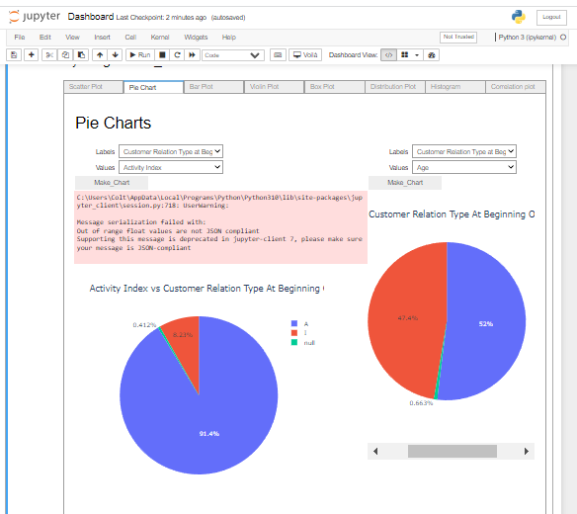
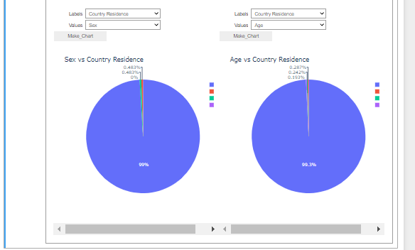

Slide 29
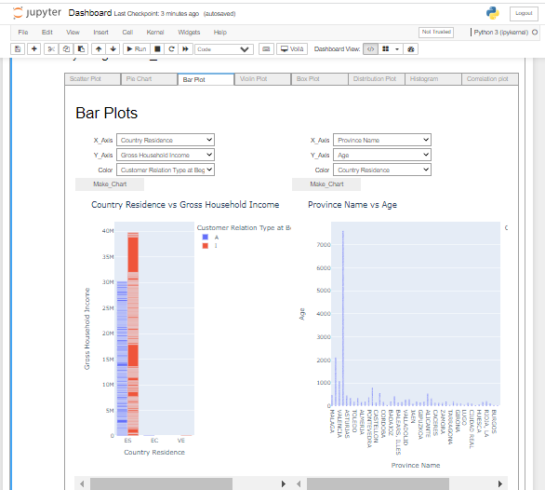
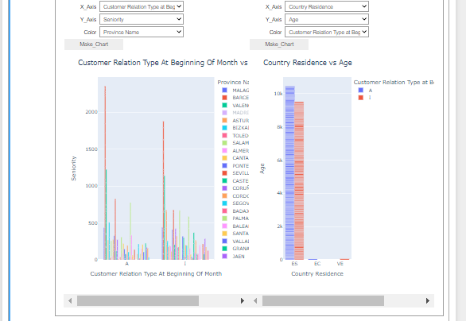

Slide 30
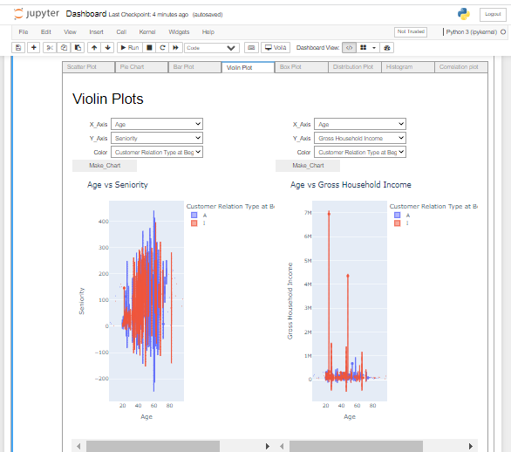
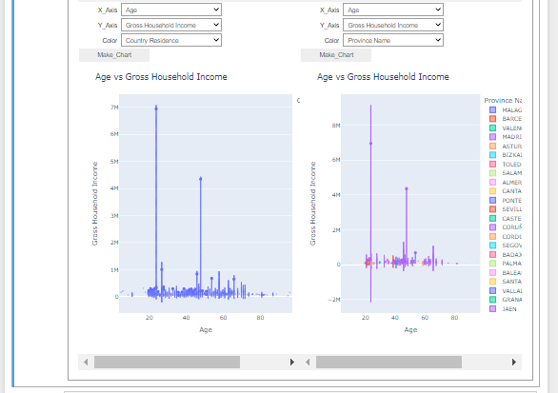

Slide 31
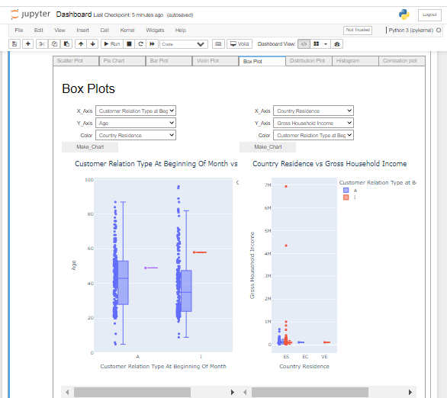
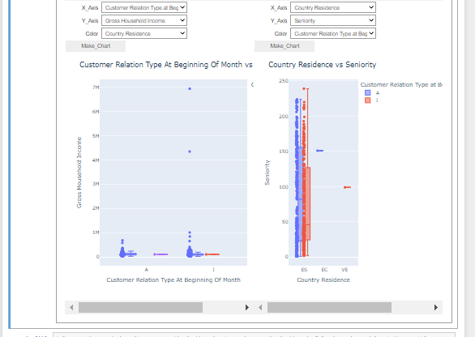

Slide 32
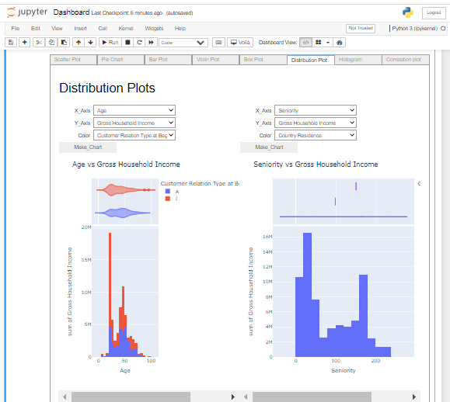
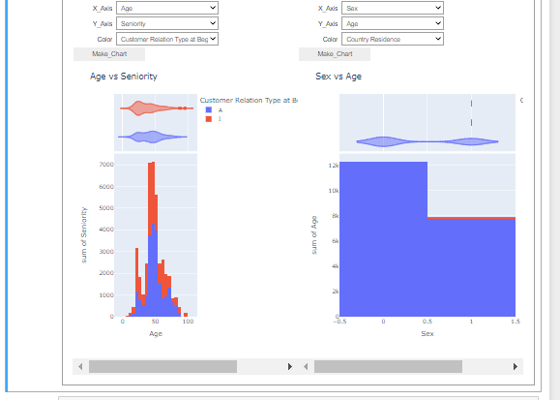

Slide 33
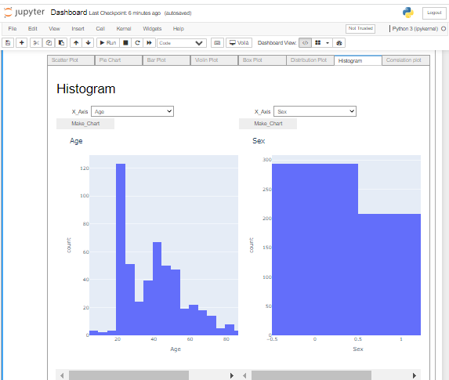
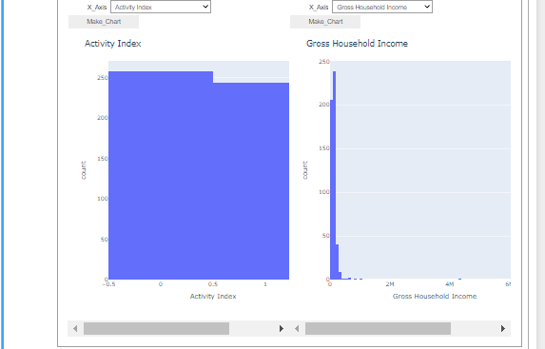

Slide 34
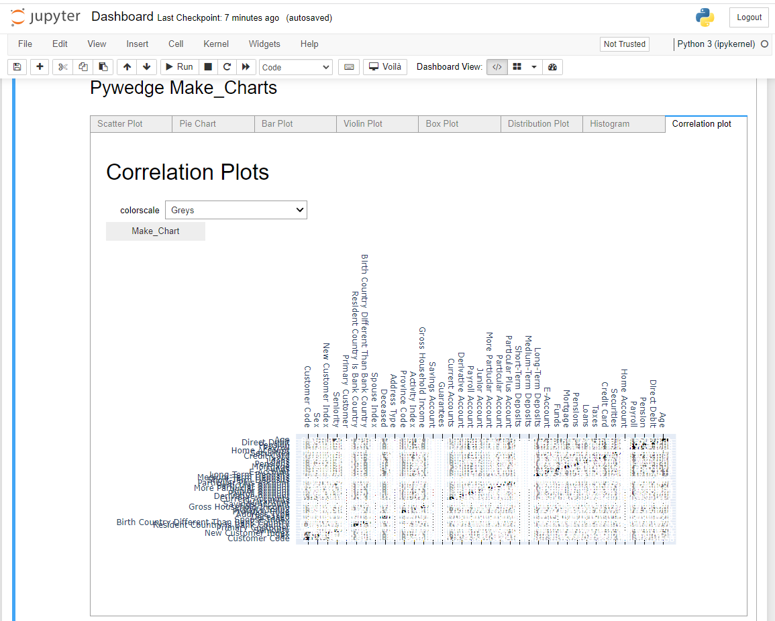

Slide 35
Thank you!

